Slide 1
IG Cloud
03-07-2019

Slide 2
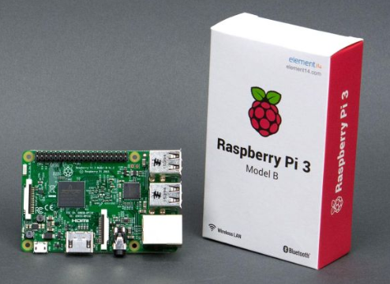
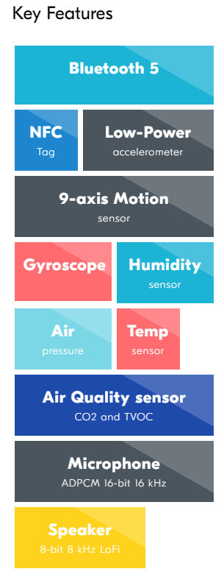
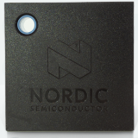
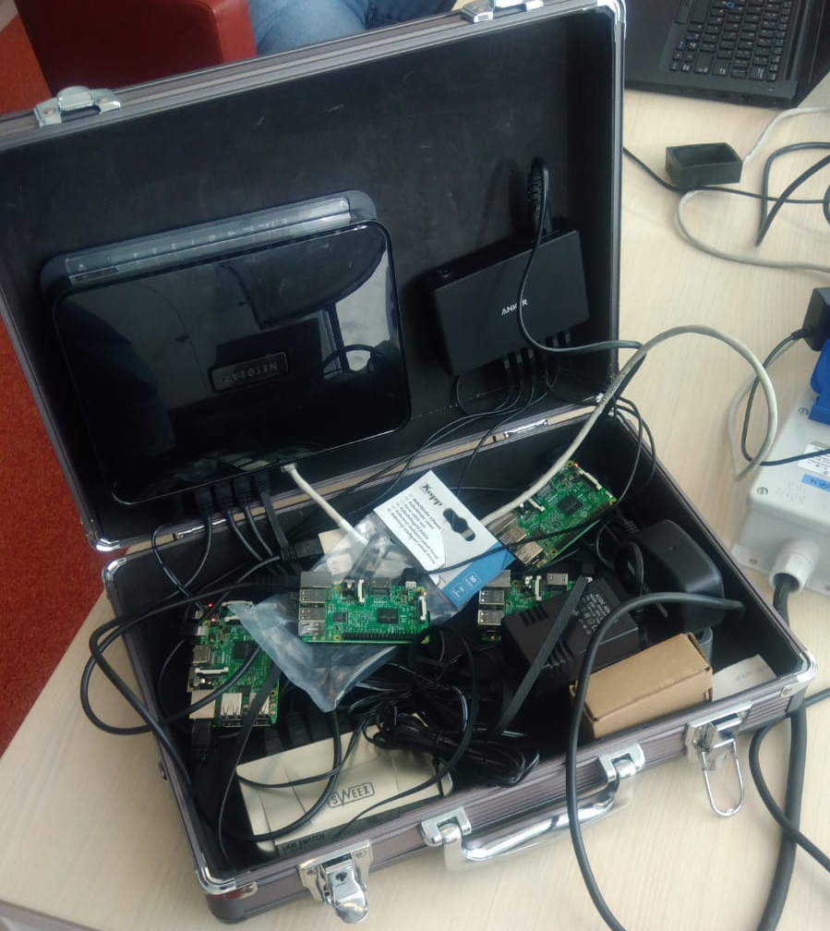
Thingy → Cloud
6x Nordic Thingy:52
6x Raspberry Pi 3
NodeJS application reads from Thingy using BT LE and sends data to AMQP connection
Source: https://github.com/rvsanten/thingy

Slide 3

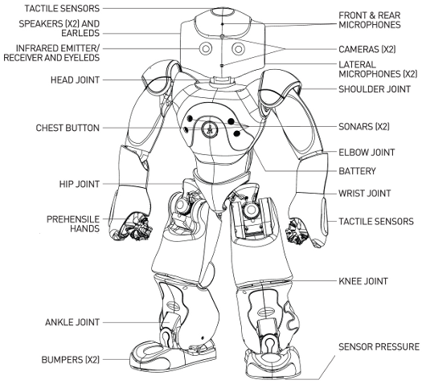
So what are the specs?
Microphone 4 directional
Speakers 4 directional
Camera 1280*960@30fps 2x
Sonar 2x
IR Leds 2x
Internet: Wifi / Ethernet
USB for connecting e.g. Arduino board for additional sensors
19 languages for recognition and text to speech
ATOM Z530 1.6GHz CPU, 1 GB
60min of active use (5h charging)
Easy programming with Choregraphe
Development on Windows, Mac and Linux
Develop in C++, Python, .NET, Java, MatLab and Urbi

Slide 4
Thingy & Nao
Connect at least 1 thingy using MQTT
Interpret this data and combine into a command to Nao
Read sensor of Nao e.g. hand, foot, head etc. and send reply back to thingy
Show Nao response on thingy by e.g. changing led color or audio

Slide 5

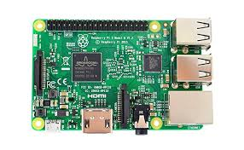


Thingy & Nao
Event Grid
Use gyro in thingy’s to e.g. move arms, use button to grip / release
Use azure function to calculate movement for Nao (e.g. prevent both hands moving at the same time)
Feedback of hand sensor

Slide 6
Pi and thingy assignments Thingy url: Thingy52
IP 192.168.1.10 pi0 Jin & Koen
IP 192.168.1.11 pi1 Gertjan & Mike
IP 192.168.1.12 p2 John & Richard
IP 192.168.1.13 p3
IP 192.168.1.14 p4
IP 192.168.1.15 p5
ssh login : pi, raspberry
git clone https://github.com/rvsanten/thingy.git
sudo node sender.js

